Slide 1
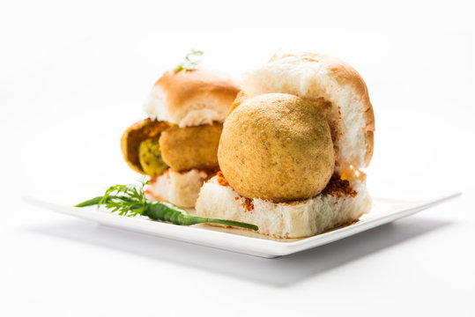
Case Study:Opening a Wada Pav Shop near Shivaji Nagar in Pune.
Presented By: Poonam Kalamkar

Slide 2
Agenda
Introduction
Problem Statement and Data Source
Objective & Methodology
Solution Description
Impact

Slide 3
Introduction
A man wants to open a Wada Pav Shop near Shivaji Nagar in Pune. He has got a location where there are other 4 more wada pav shops. So we need to help build a strategy that will help him become the best selling Wada pav shop seller in that area making more profit.

Slide 4
Problem Statement and Data Source
A man wants to open a Wada Pav Shop near Shivaji Nagar in Pune. He has got a location where there are other 4 more wada pav shops. He is not able to understand what will be the strategy to take over his clients.So there are many questions like below which he has in his mind right now before opening the shop.
a. What will be the price of each Wada Pav?
b. How will he differentiate from the other competitors?
c. How will you bring insights when he has no data of his shop?
d. Why will be the Customer comes to your shop? (What will be the positioning)
e. What Machine Learning Models you will used to take to solve this Problem Statement?
Whether Data Science is really required or not? How will you come to a solutions which will make him an entrepreneur and will help him to grow?
f. How will he get the required data which is required for analysis ?,etc.

Slide 5
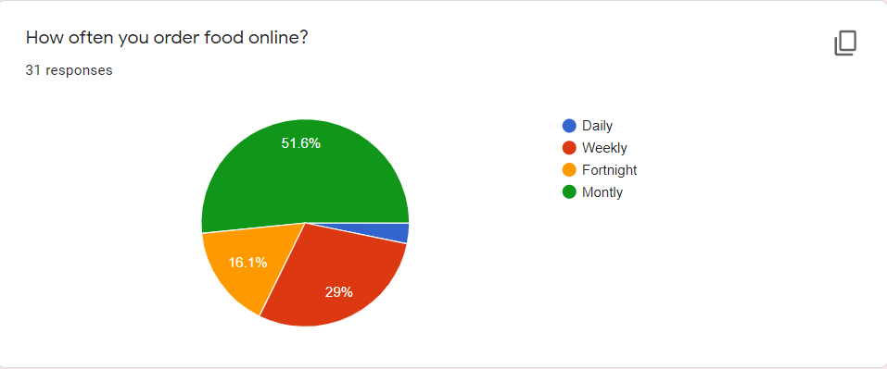
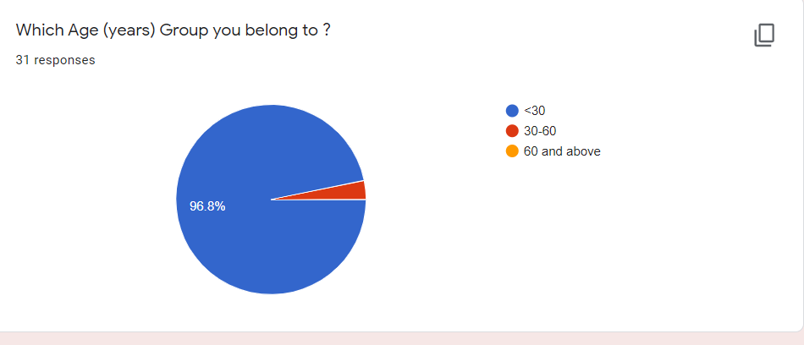
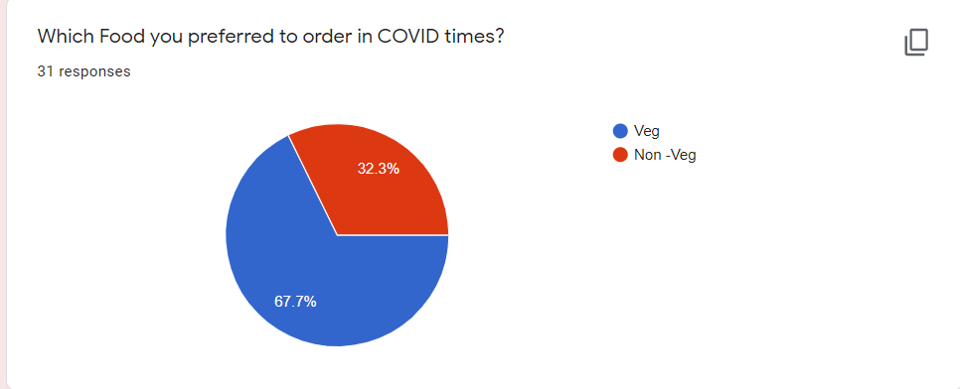
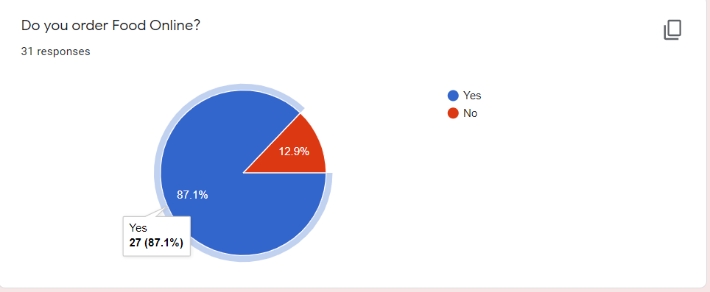

Slide 6
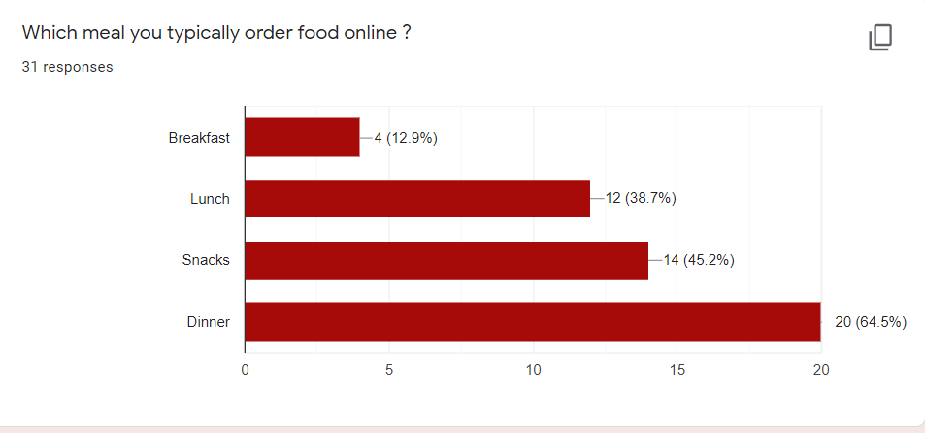
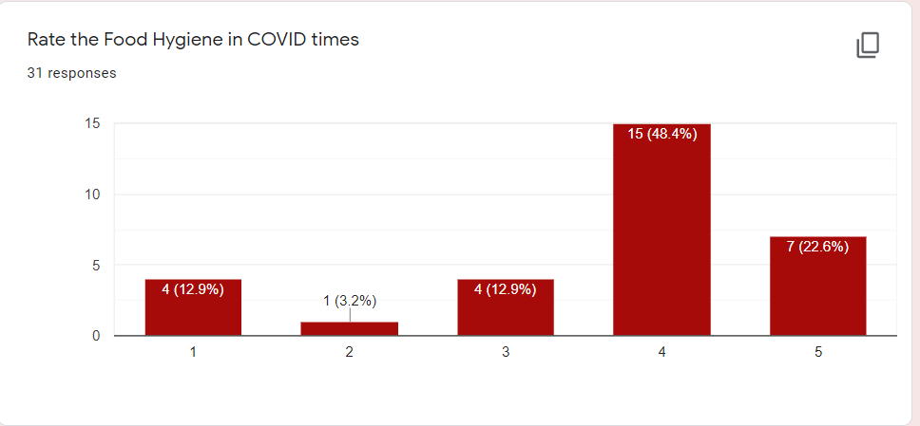
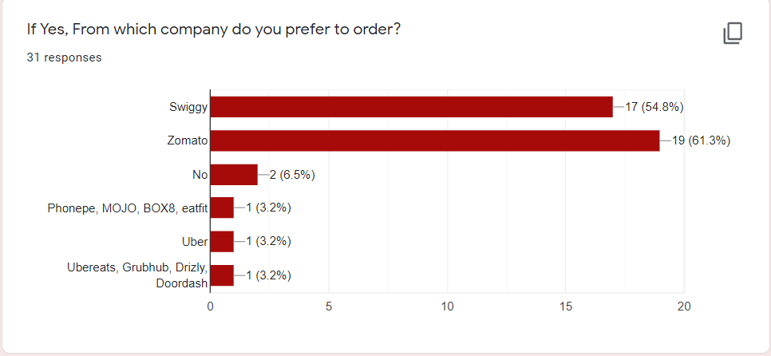
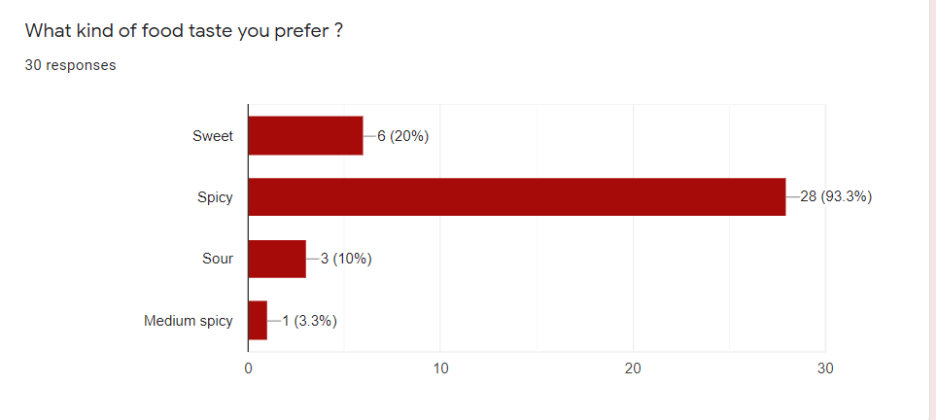

Slide 7
Objective & Methodology
Objective:
Make the Wada Pav shop seller the best seller in Shivaji Nagar,Pune making him an entrepreneur which will help him to grow his business.
Methodology:
Carry out survey in the area and get answers to the below Questions so that we can get an idea
what kind of vada pav people eat (Mumbai Style,Chinese,Chesse,etc)?What is their preferences ?
What all things like to have with vada pav ?
Who is the current best seller in that area who sells the best vada pav?What all things he has which other people don’t have?
How can we tie up with Swiggy ,Uber eats and other food delivery apps,?
What time there is more crowd in that area so we can be prepared with the required items?
What all things is the shop surrounded around (Like Garden,School,Colleges,offices,etc)So we can identify the buying pattern and then decide on price of food and other offers ?

Slide 8
Solution
We can carry out survey with the above questions and study the pattern using various algorithms in machine learning like the Market Basket Analysis. This algorithms will help us understand the buying patterns of the people eg. If person buys eggs and milk he is likely to buy the Bread.SO by identifying the patterns and forming the association rule we can identify and study the required demand of consumers in that area.
So in our example its like if person is buying vada pav in summer he might also go with Lassi ,coke or other things. This kind of rule association will help us with understanding the consumer demands .
We can also use algorithms like clustering were we can form a group of consumers and then decide if new consumer comes which group it will form using nearest neighbour algorithms.

Slide 9
Impact
This Strategy will help us understand what the market wants so we can be prepared with the required data so people will be happy and we can attract lot of consumers to our shop and earn more profit making the owner the best seller and make him an entrepreneur and will help him to grow earning profit and using the similar kind of strategy and grow his business more.

